Slide 1
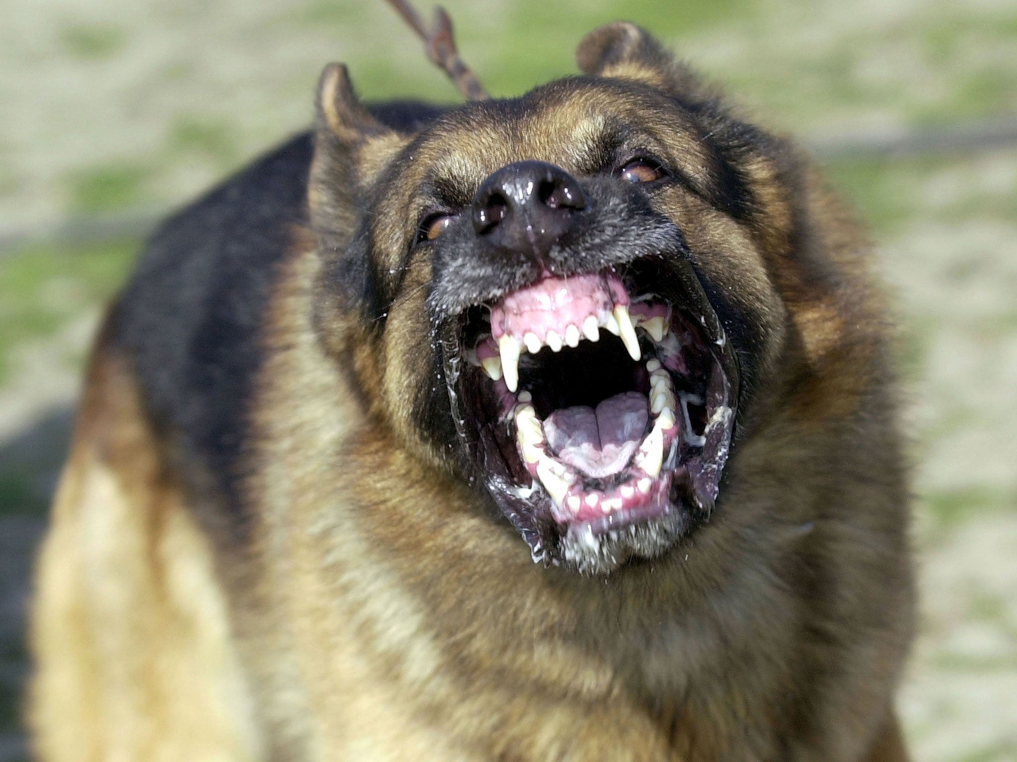

Why the ownership of
“dangerous dogs” should be banned
OWE

Slide 2
Dangerous Dog Act
The Dangerous Dog Act of 1991 states that it is illegal for persons of the United Kingdom
to be in possession or have custody of dogs bred for fighting.
The DDA prohibits certain types of dogs and allowing a dog of any type to be dangerously out of control in a public or private place .The law also states that such dogs shall be seized.

Slide 3
Statistics
Some even show aggressive behaviour towards their owners.
Between 2013 and 2019, 22 people died from dog bites.
9,277 hospital admissions have been made in the UK during 2023 alone.
Statistically the most dangerous dog breed is the Pitbull terrier.

Slide 4


Our Opinions
My opinion is that dangerous dogs should only be used by the police and the armed forces,
as they are dangers to society.
In my opinion, I think that if you want a dangerous dog, you should ask the government for permission and have your record checked.

Slide 5
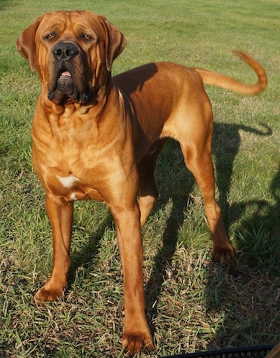
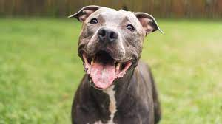
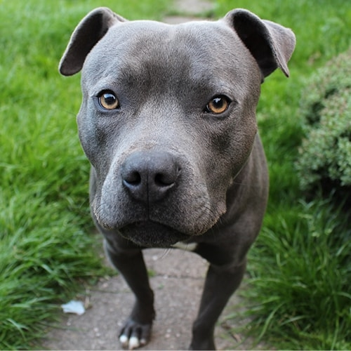
Some dogs classed as dangerous in the UK.
Pitbull
Japanese Tosa
Staffordshire
Bull Terrier

